Slide 1
Static Net Connectivity in Linux

Slide 2
Some important commands for internet connectivity
#redhat-config-network //to open network configuration manager
ifconfig // to get information about active network
ping //used to test the reachability of a host

Slide 3
Steps to connect Internet Statically

Slide 4
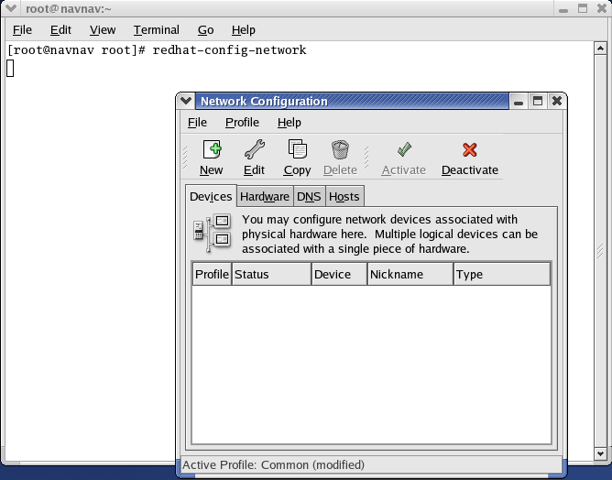
Go to terminal and type redhat-config-network
In network configuration manager, Select new

Slide 5
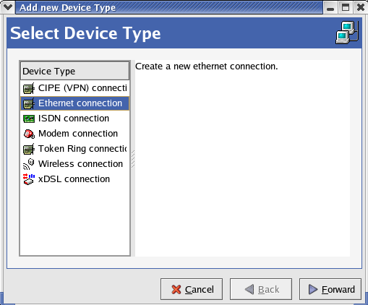
Select Ethernet connection and click on Forward.

Slide 6
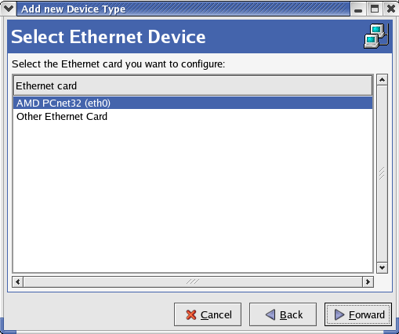
Select AMD PCnet32 (eth0) and click on Forward

Slide 7
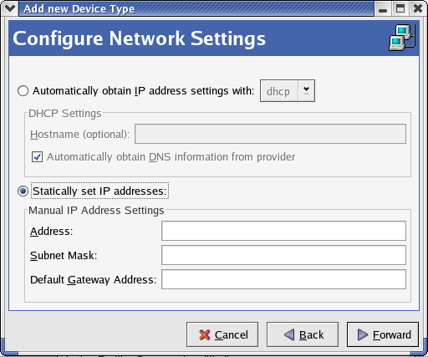
Select Statically obtain IP address. You can enter IP address setting manually here or you can simply click on forward button without entering any IP address settings. These details can be filled later on also.

Slide 8
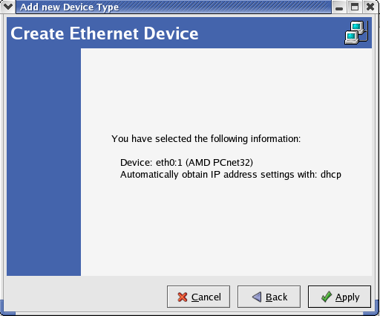
Click on apply

Slide 9
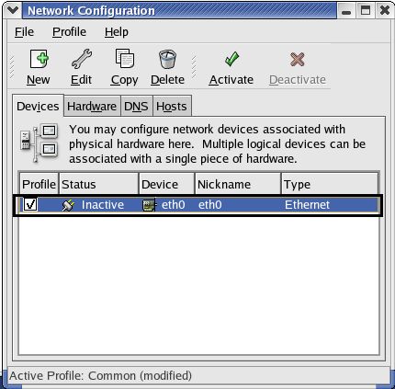
Now doubleclick on the blue link which is highligted here.

Slide 10
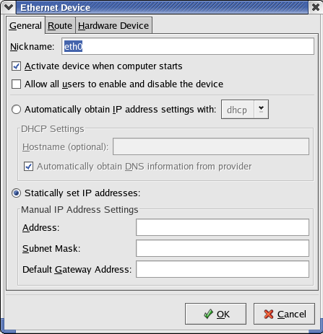
IP address, Subnet mask and Default gateway address is to be provided here. We have to check these details from windows as mentioned in the next slide.

Slide 11
To check network details from windows
There are two ways to get the information about IP address,default gateway and subnet mask:
First: Go to command prompt of windows by typing cmd and then type ipconfig command to get information about IP address, default gateway and subnet mask. To get information about DNS, type ipconfig /all
Second: Go to the status of currently connected network and then click on details.

Slide 12
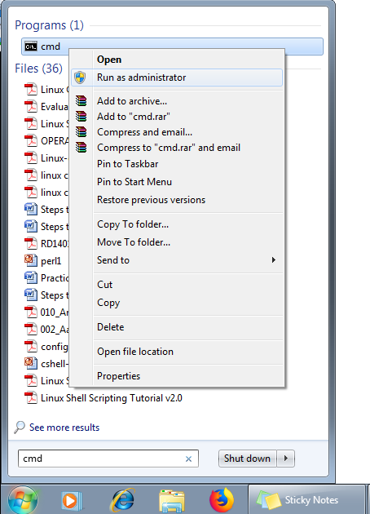
First Method to check network details

Slide 13
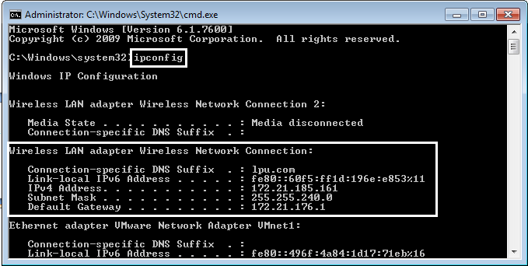
Type ipconfig on command prompt to check the network details and the IP address, subnet mask, default gateway will be shown same like highlighted part. Note these details and enter in linux.

Slide 14
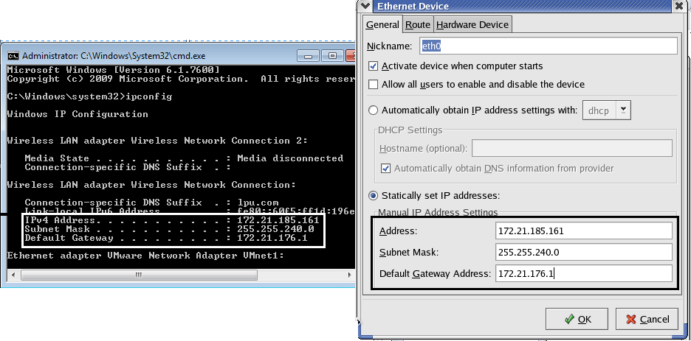
Enter these details and click on OK

Slide 15
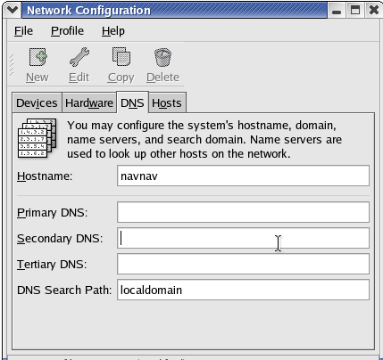
Now go to DNS tab and provide primary and secondary DNS.
To check DNS we have to use the second method.

Slide 16
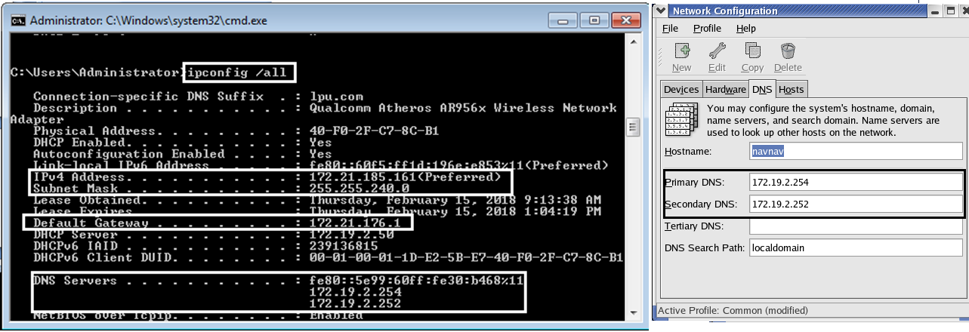

Slide 17
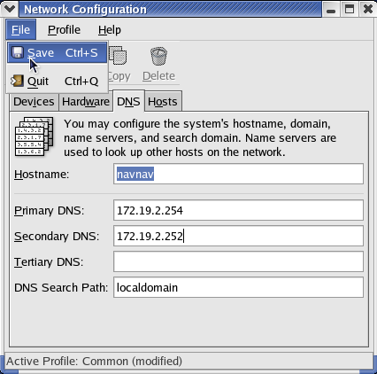
After you enter DNS, goto File and click on save.

Slide 18
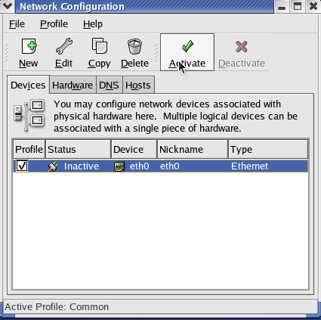
Go to Devices tab and click on Activate.
Now Internet has been configured. Go to browser or terminal to ping IP address.

Slide 19
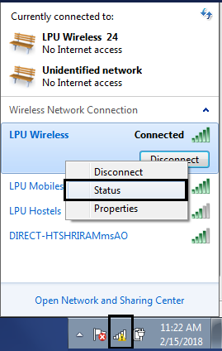
Second Method to check network details
Go to currently connected network connection. Right click on that and then click on status option.

Slide 20
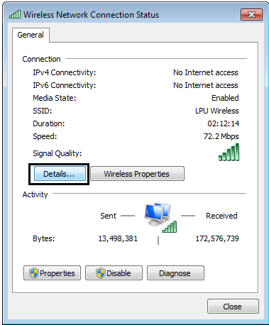
Now click on Details

Slide 21
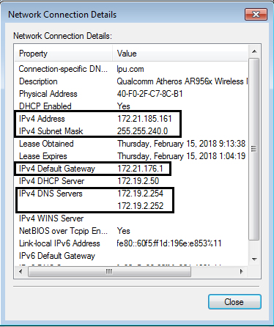
Note IP address, subnet mask, default gateway and DNS server and provide all the details in Linux.
After this click on Activate to activate the internet connection.

Slide 22
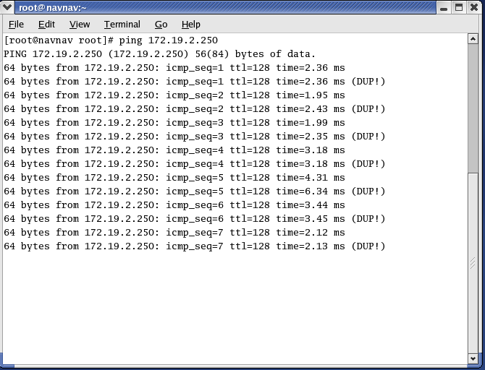
Now ping any IP address

